Slide 1
Reminder Task
Kelvin Chan
Synergy College
29-March-2023

Slide 2
Introduction
A reminder task is a type of task that helps individuals to remember important events, appointments, or deadlines. With the increasing demands of modern life, it can be challenging to keep track of everything we need to do.

Slide 3
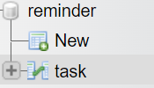
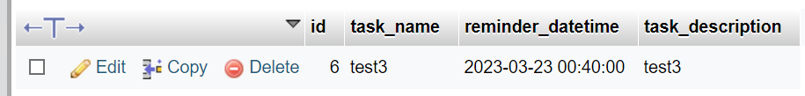
Database
First I have create a table for this project. Database name is reminder and the table name is task.
Secondly, I create the column in task like `id`, `task_name`, `reminder_datetime`, `task_description`.

Slide 4
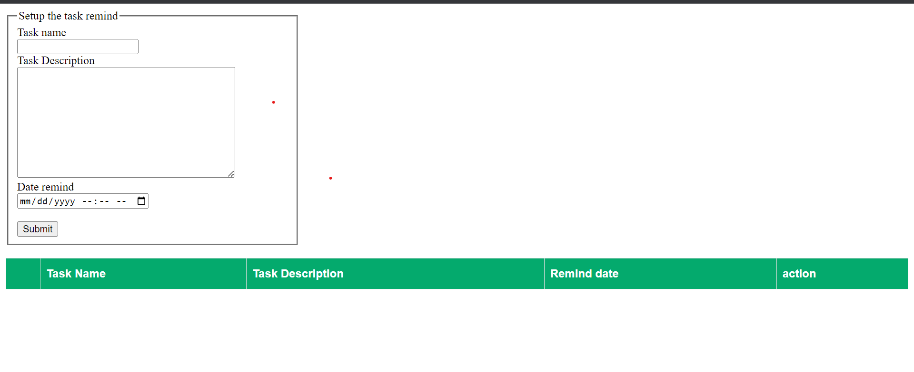
Interface
This is my reminder task. Task Name and Task Description we can insert every word for reminder ours. After we can set the date at Date remind to reminder ours.

Slide 5
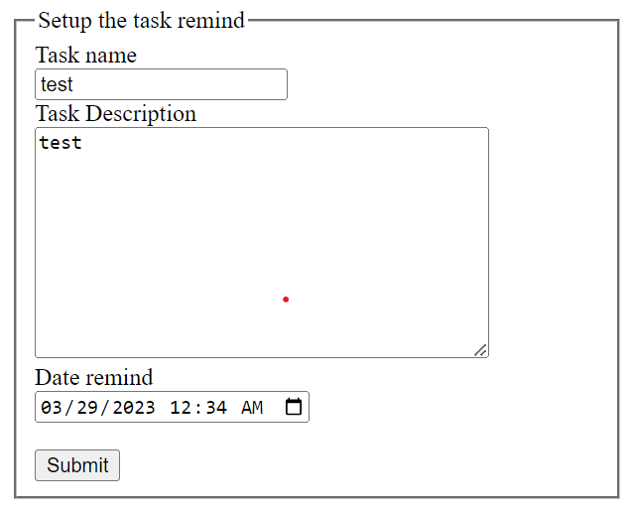
Setup The Remind
Start, we can setup the task remind like picture. If click the submit it will show a alert for notify task setup success.

Slide 6
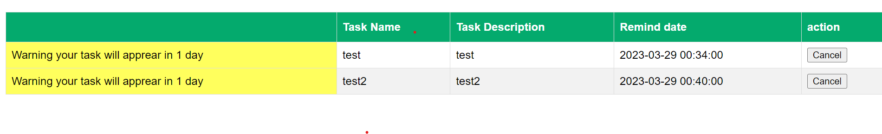
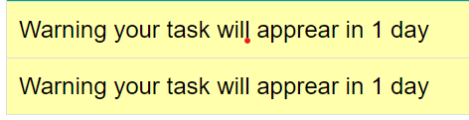
Show Interface
After setup remind the remind will show at interface like picture, if the date is expired it will show a alert for notify user like “Expired”. So if the task will expire more one day the text will change to color yellow ; conversely the task is expired in today will change to color red.

Slide 7
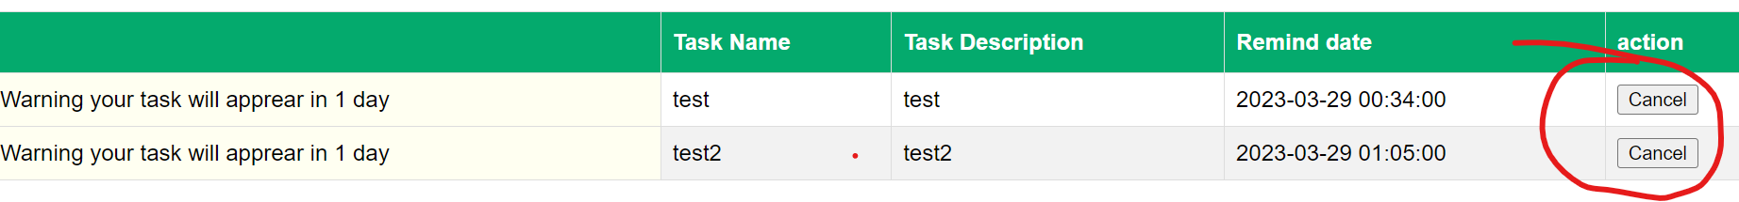
Cancel Button
Finally, I have create a cancel button to cancel the task remind.When I click cancel the task remind will delete from database. When the task remind is delete the interface will also will delete its.

Slide 8
Thank You
Completion Date :
29-March-2023

